Slide 1
Project Name CHURN RATE PREDICTION
MENTORS:
VINOD
HARSHAL
TEAM MEMBERS:
Nagarjun
Prathmesh
Premsai
Meghana S
Ravi Yadav
Nandeesh Kumar K C
Akhlak Ansari

Slide 2
Business Problem : Churn rate prediction : Churn rate, sometimes known as attrition rate, is the rate at which customers stop doing business with a company over a given period of time. and also the customer who are likely to cancel the booking or subscription.
Objective :
To predict whether a customer is going to cancel the booking or not .
Churn rate has major impact on company’s revenue.

Slide 3
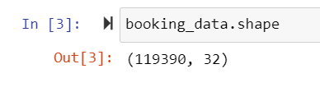
Dataset details This data is about the hotel booking of a city hotel and resort hotel from the year 2015 to 2017 . it also includes about booking that arrived in the hotel and booking that were cancelled with some other important features. Observations This Dataset Contains of 119390 Rows and 32 Columns.
Data Analysis :
Data set contains 119390 entries and 32 columns.
It has 129625 null values present.
Data frame column has 11625 unique values.
Data type: float64(4),int64(16),object(12)

Slide 4
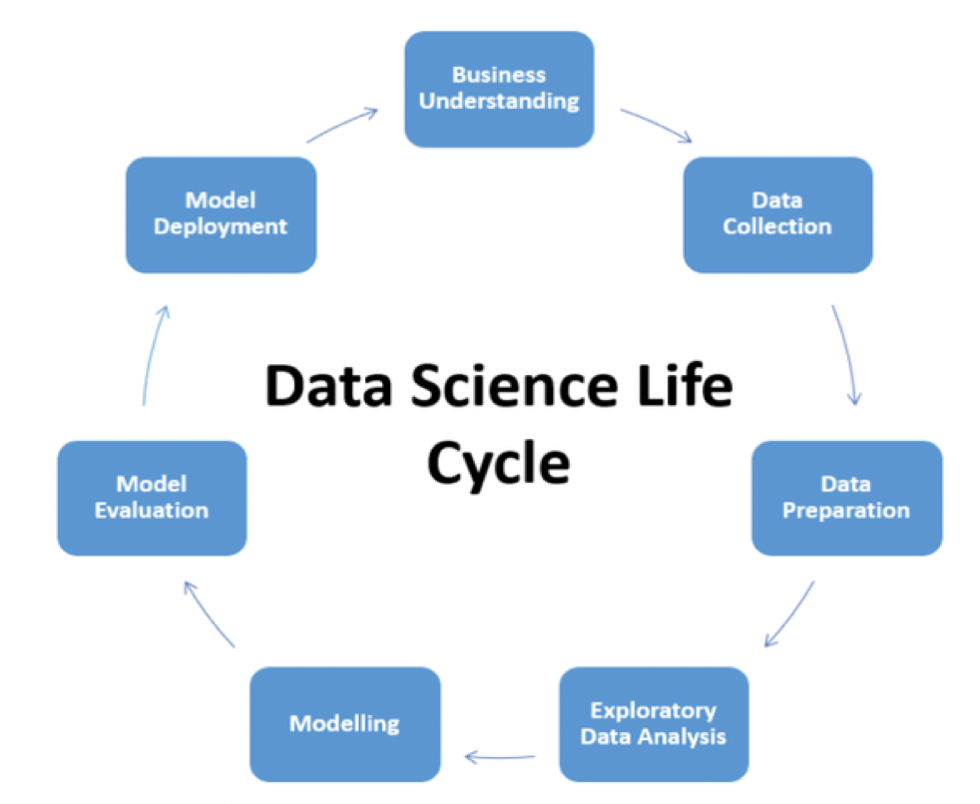
Project Architecture / Project Flow

Slide 5
Solution :
By
By analysing the data we can conclude that it is a binary classification problem .
for classification problem we can apply machine learning algorithms like logistic regression and random forest model with some ensembles techniques.

Slide 6
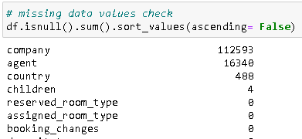
Data pre-processing
There are 126925 null values in total

Slide 7
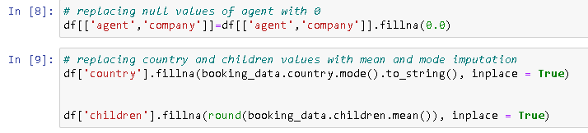
Data pre-processing(cont..)
Replacing the null values of agent and company values with 0
Replacing the country null values with mode imputation
Replacing the children null values with mean imputation

Slide 8
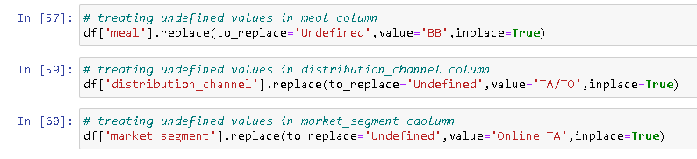
Data pre-processing(cont..)
Treating undefined values with in meal, distribution_channel and market_segment columns with mode imputation

Slide 9
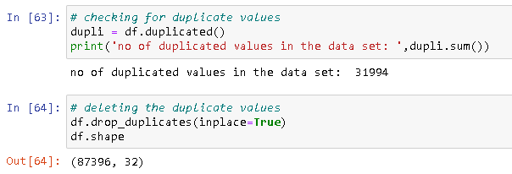
Data pre-processing(cont..)
Checking for duplicate values and deleting them

Slide 10
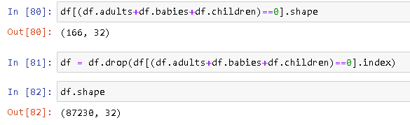
Data pre-processing(cont..)
Deleting rows that had ‘0’ in adults, babies and children columns combined

Slide 11
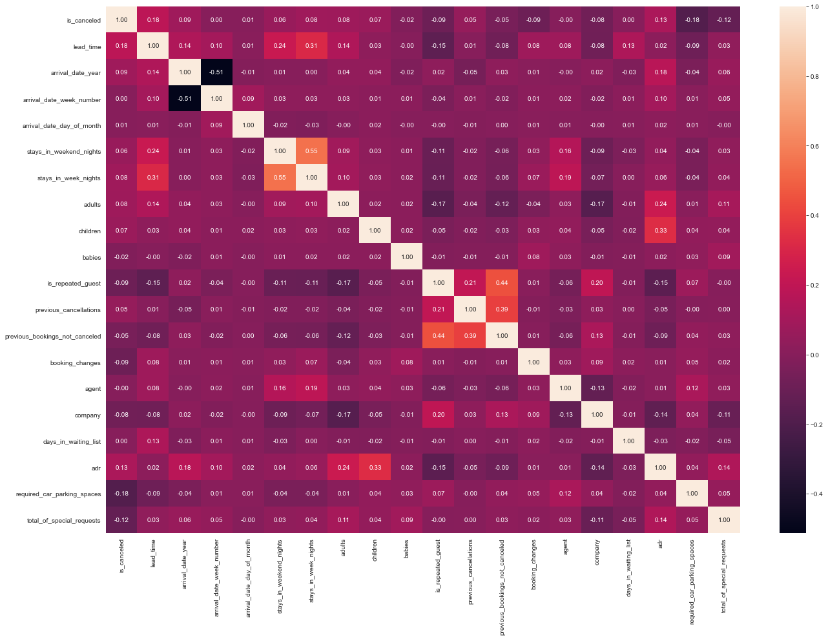
Exploratory Data Analysis (EDA)
Finding correlation through heatmap

Slide 12
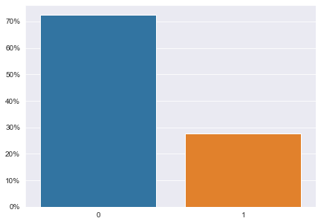
Cancelled vs not cancelled ratio

Slide 13
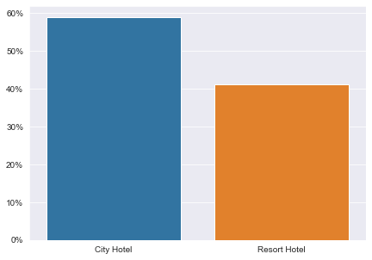
booking % comparisons wrt city hotel and resort hotel

Slide 14
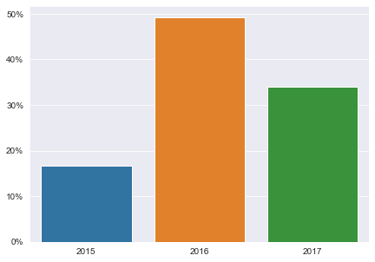
percentage of booking for each year

Slide 15
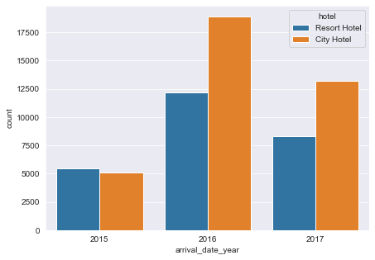
the same graph by separating hotel and plotting

Slide 16
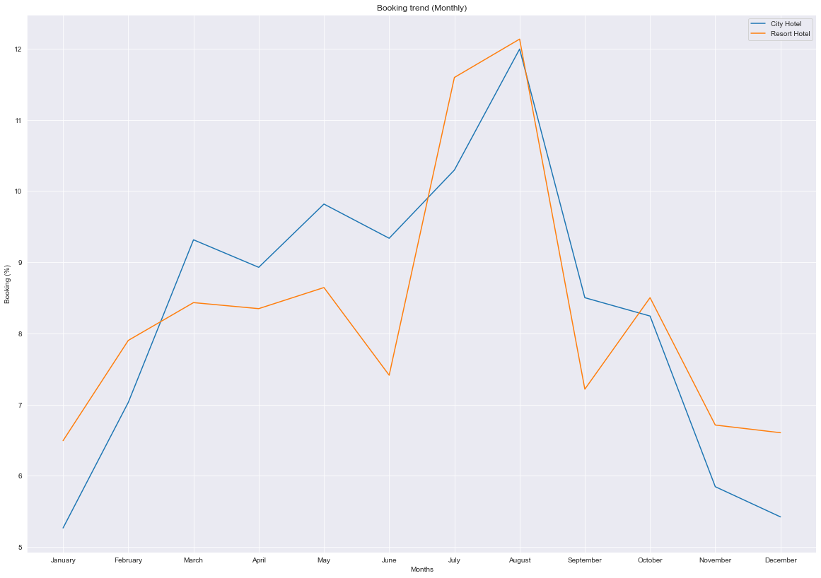
busiest month for the hotel

Slide 17
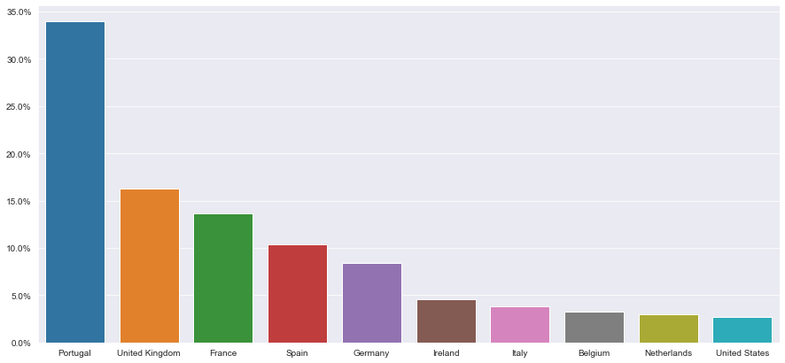
from which country more guests have visited the hotel

Slide 18
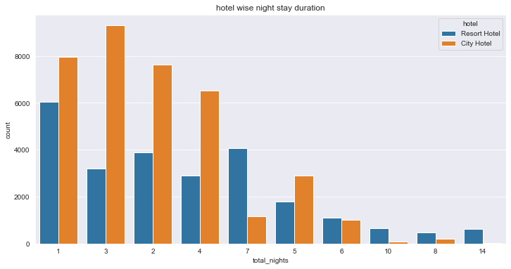
Hotel wise night stay duration

Slide 19
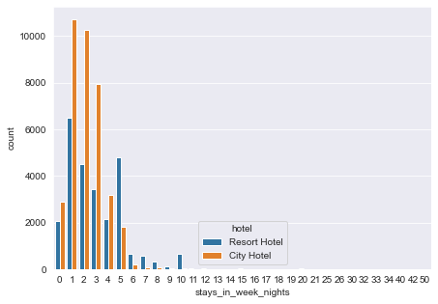
No of people stayed in week nights (mon-fri)

Slide 20
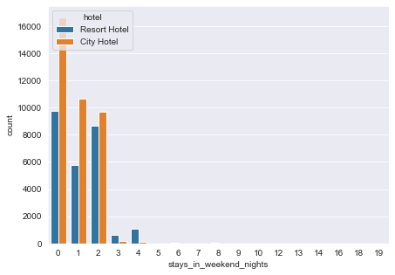
No of people stayed in weekend nights (fri/sat – Sunday)

Slide 21
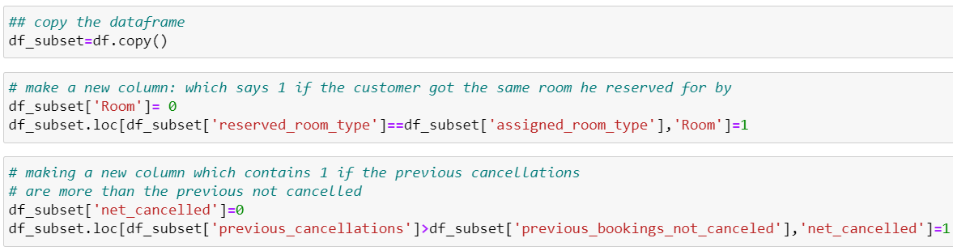
Feature Selection and Feature Engineering
We will create relevant features and remove the irrelevant or less important features.

Slide 22
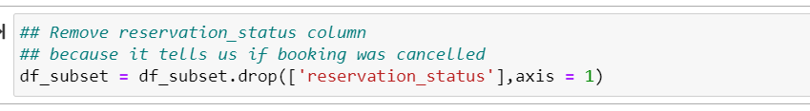
Now remove these unnecessary features
Let’s also remove the reservation_status.Even though it is very important feature,but it already has information about cancelled booking.

Slide 23
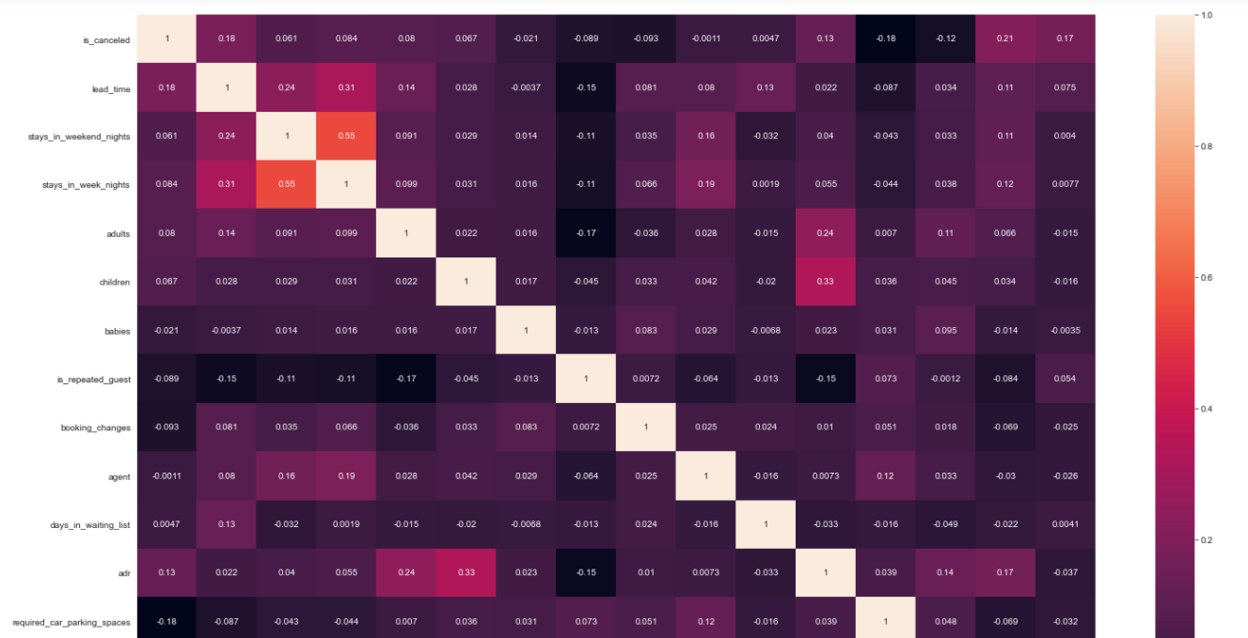
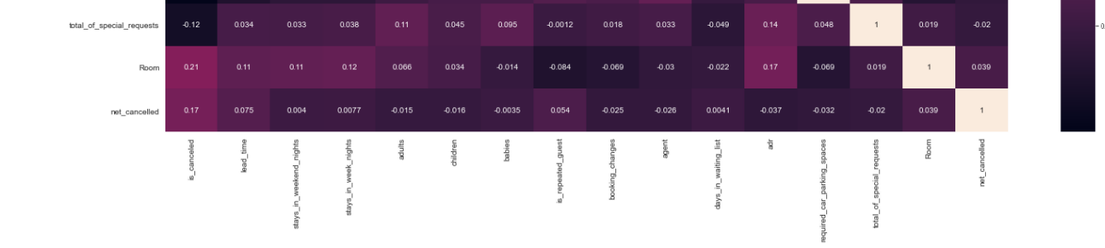
Let’s Plot the heatmap and see the corelation

Slide 24
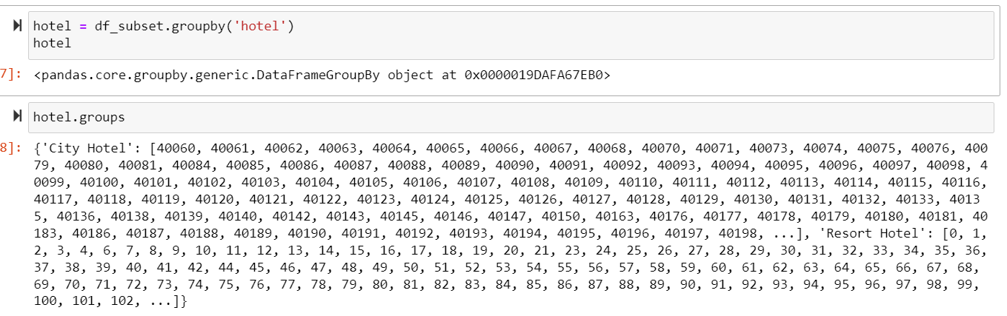
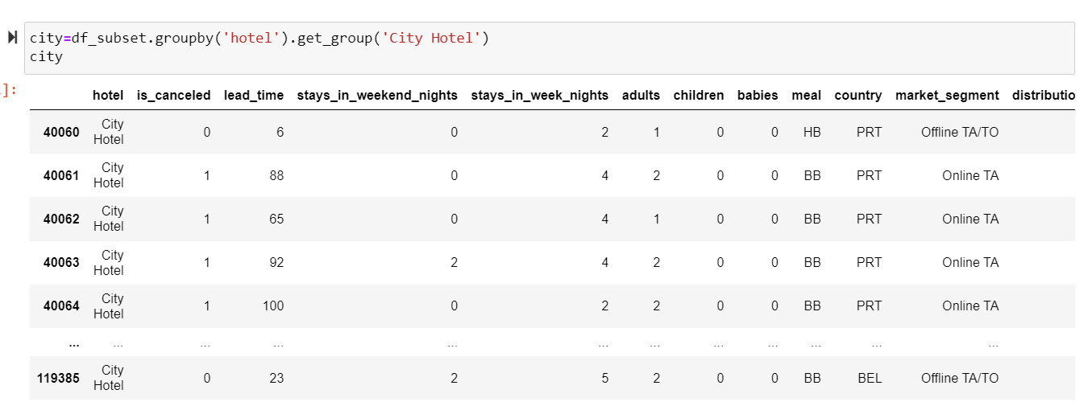
Splitting city and resort hotel and building the model

Slide 25
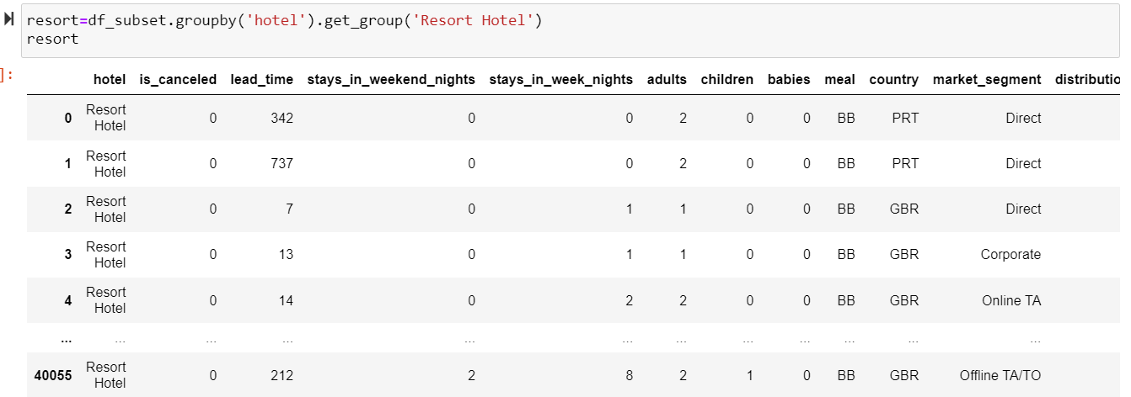
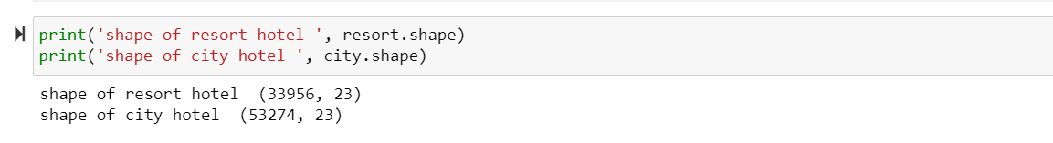

Slide 26
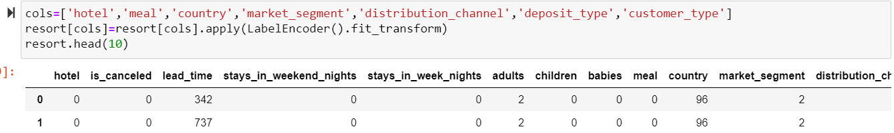
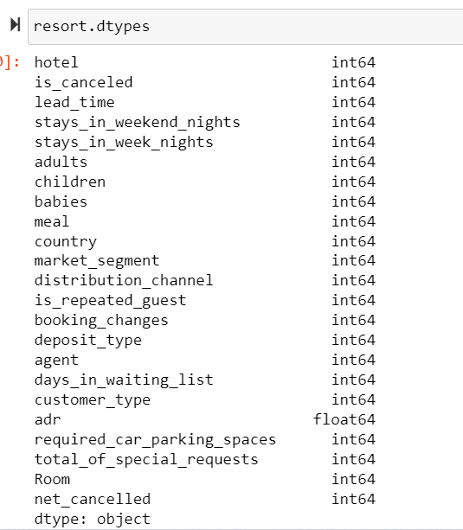
Applying label encoding for categorical columns
1.Resort hotel

Slide 27
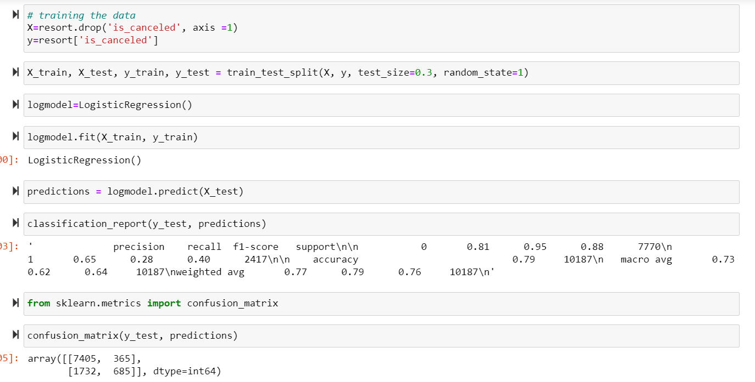
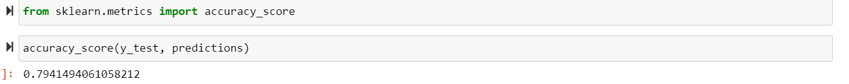
Training and testing the data.

Slide 28
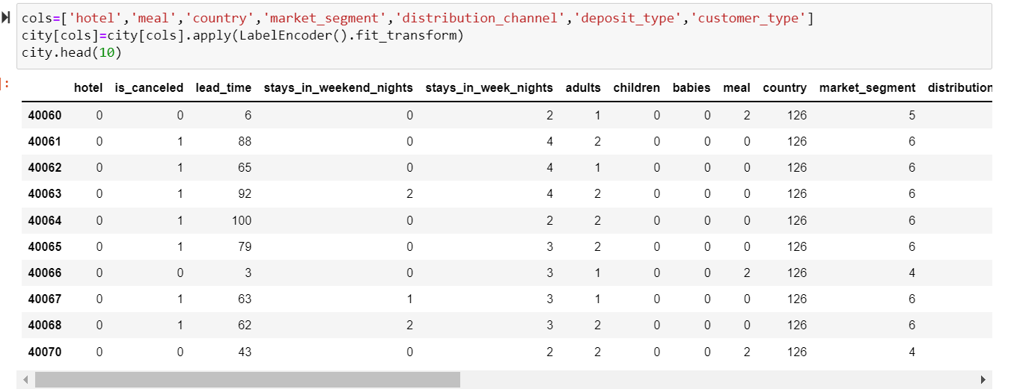
2.City hotel :

Slide 29
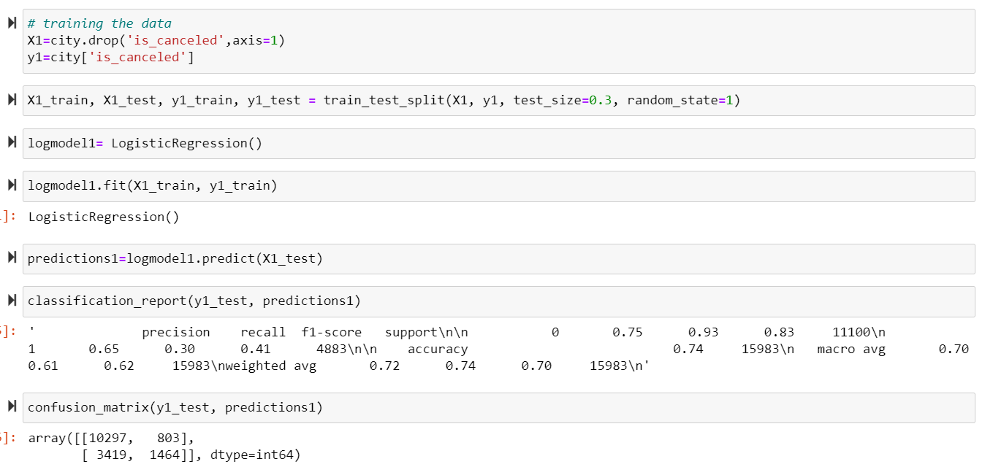
Training and testing the data.

Slide 30
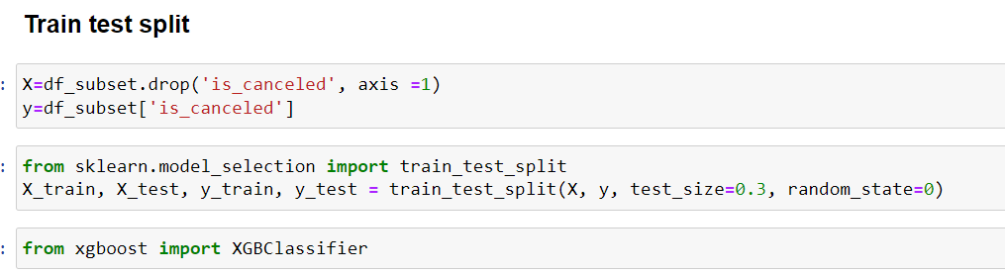
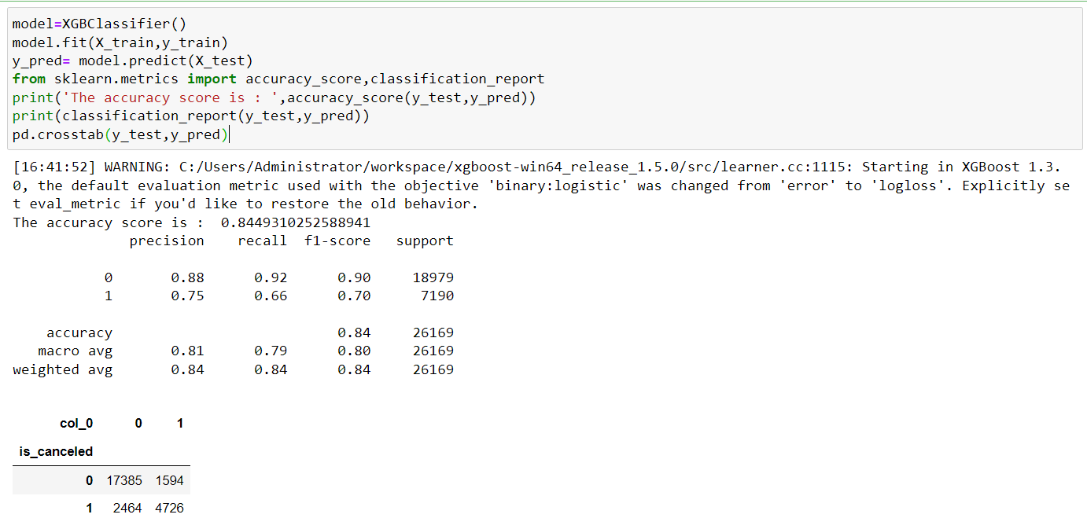
Using Gradient Boosting algorithm :

Slide 31
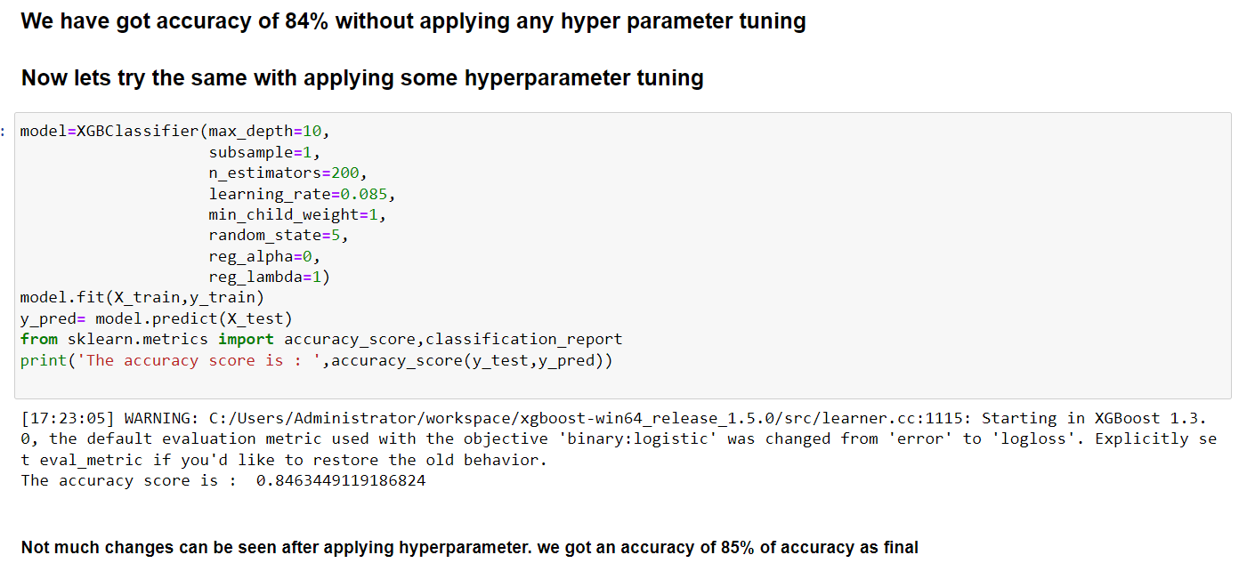

Slide 32
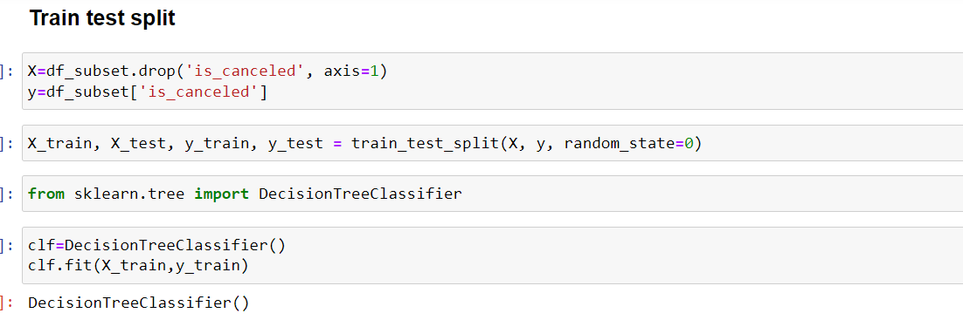
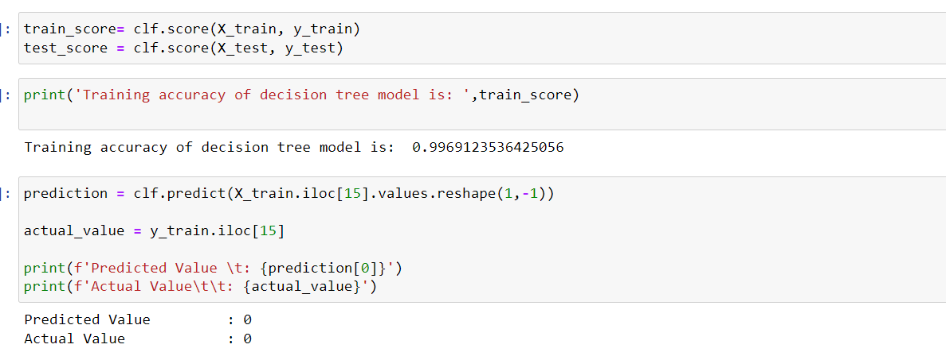

Slide 33
Choosing the best algorithm for Model Deployment
As we saw that decision tree had the best accuracy we will be choosing the same for our model deployment

Slide 34
MODEL DEPLOYMENT using STREAMLIT

Slide 35
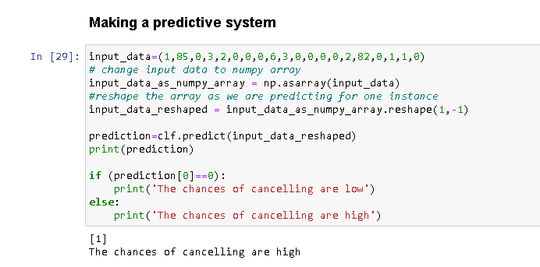
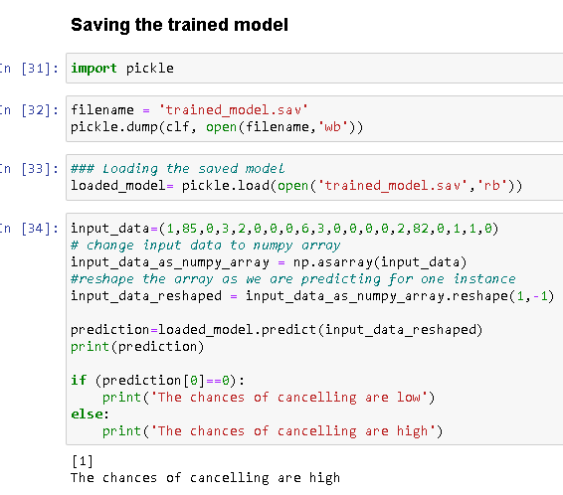
Model deployment contd…

Slide 36
THANK YOU

